Slide 1
Bayes Network, Reinforcement Learning and CNN
Unit IV

Slide 2
Bayesian Decision Theory
Marginal, Conditional and Joint Probabilities
Marginal Probability
It is the probability of an event irrespective of any other factor/event/circumstance. Basically, you ‘marginalize’ other events and hence the name.
It is denoted by P(A) and read as “probability of A”.
Conditional Probability
Conditional probability is when the occurrence of an event is wholly or partially affected by other event(s).
It is denoted by P(A|B) and read as “probability of A given B”.

Slide 3
Joint Probability
Joint probability is calculated when we are interested in the occurrence of two different events simultaneously.
It is denoted by P(A, B) and read as “probability of A and B”.
Difference between Probability and Likelihood:
Probability refers to the chance that a particular outcome occurs based on the values of parameters in a model.
Likelihood refers to how well a sample provides support for particular values of a parameter in a model.

Slide 4
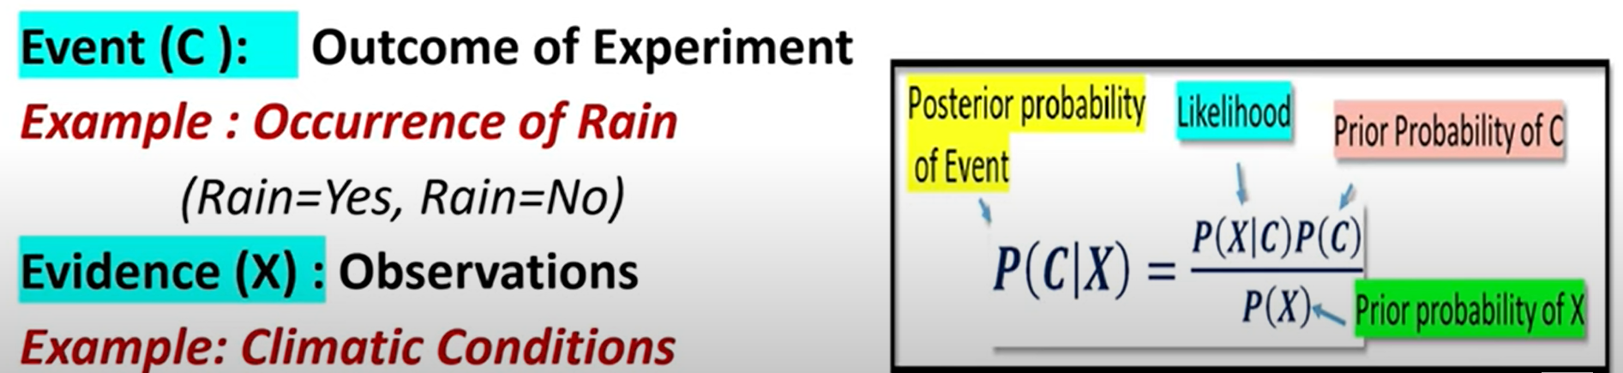
Bayes Theorem
It helps to estimates the posterior probability of an event, based on the prior knowledge of the evidences (observation).
Dark cloud = yes, Wind = speedy

Slide 5
Bayesian Network
A Bayesian network is a probabilistic graphical model which represents a set of variables and their conditional dependencies using a directed acyclic graph.
It is also called a Bayes network, belief network, decision network, or Bayesian model.
Bayesian networks are probabilistic, because these networks are built from a probability distribution, and also use probability theory for prediction and anomaly detection.
It can also be used in various tasks including prediction, anomaly detection, diagnostics, decision making under uncertainty.
It consists of two parts:
Directed Acyclic Graph
Table of conditional probabilities.

Slide 6
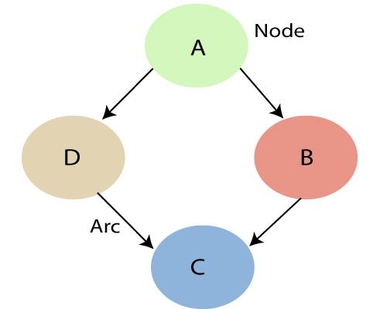
Each node corresponds to the random variables, and a variable can be continuous or discrete.
Arc or directed arrows represent the causal relationship or conditional probabilities between random variables.
These links represent that one node directly influence the other node, and if there is no directed link that means that nodes are independent with each other
Each node in the Bayesian network has condition probability distribution P(X_{i} |Parent(X_{i}) ), which determines the effect of the parent on that node.

Slide 7
Windy
Cloudy
P(C)
0.002
P(W)
0.001
W | C | P(R)
T | T | 0.95
T | F | 0.95
F | T | 0.29
F | F | 0.01
Rains
Wet Grass
Take off from work
R | P(WG)
T | 0.95
F | 0.05
R | P(O)
T | 0.7
F | 0.01

Slide 8
Find the probability of wet grass:
P(WG) = P(WG|R) * P(R) + P(WG|¬R)* P(¬R)----------- (1)
= 0.95 *P(R) + 0.05 *P (¬R)
P(R) = P(R|W,C)*P(WɅC)+P(R|¬W,C)*P(¬WɅC)+ P(R|W,¬C)*P(WɅ¬C)+ P(R|¬W,¬C) *P(¬WɅ¬C)-----(2)
=0.95*0.001*0.002+0.29*0.999*0.002+0.95*0.001*0.998+0.01* 0.999*0.998
P(R) = 0.00252.
Similarly
P(¬R) = 0.99744
P(WG) = 0.0521

Slide 9
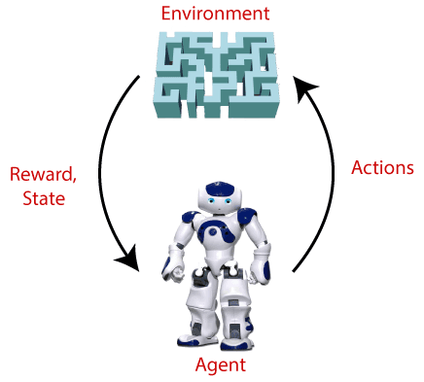
What is Reinforcement Learning ?
Definition: Reinforcement Learning is a feedback-based Machine learning technique in which an agent learns to behave in an environment by performing the actions and seeing the results of actions. For each good action, the agent gets positive feedback, and for each bad action, the agent gets negative feedback or penalty.
In Reinforcement Learning, the agent learns automatically using feedbacks without any labeled data, unlike supervised learning.
Since there is no labeled data, so the agent is bound to learn by its experience only.
RL can be used for game-playing, robotics etc.,

Slide 10
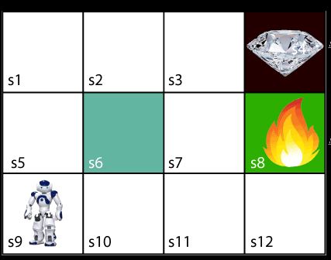
Characteristics of Reinforcement Learning
Sequential Decision Making: From the figure, it can be seen the path from start to goal state is not done in one step.
It is a sequence of decisions that leads
to the goal.
One wrong move may result in failure.
Actions are interdependent: the
agent’s next action is dependent on
reward received in the previous action.
Delayed feedback: often get reward for
a particular action, but the overall feedback is delayed. One must
spend many moves to get final success or failure.

Slide 11
Challenges of Reinforcement Learning
Reward design: is a big challenge as in many games, as determining the rewards and its value is challenge.
Partially observable states: in some games, the states of the opponent cannot be fully viewed.
Time consuming operations: more states spaces and possible actions may complicate the scenario, resulting in more time consumption.

Slide 12
Different Types Of Environments in Reinforcement Learning
1. Deterministic vs Stochastic Environment
Deterministic Environment: In a deterministic environment, the next state of the environment can always be determined based on the current state and the agent’s action. Example: chess.
Stochastic Environment: In a stochastic reinforcement learning environment, we cannot always determine the next state of the environment from the current state by performing a certain action. Example: driverless car.
2. Single Agent vs Multi-Agent environment
Single Agent Environment: In a single agent environment, there is only one agent that exists and interacts with the environment. For example, if there is only one agent that is driving the car from point A to point B then it is a single agent environment. Example: vacuum cleaner.
Multi-Agent Environment: In a multi-agent environment, there are more than one agents that are interacting with the environment. Example: computer games.

Slide 13
3. Discrete vs Continuous Environment
Discrete Environment: In a discrete environment, the action space of the environment is discrete in nature. Example: chess
Continuous Environment: In a continuous environment, the action space of the environment is continuous in nature. Example: driverless car.
4. Episodic vs Sequential Environment
Episodic Environment: In an episodic environment, the agent’s actions are confined to the particular episode only and not on any previous actions.
Sequential Environment: In a sequential environment, the agent’s actions are connected with the previous actions it took. For example, in Chess, the current state of the game was reached due to all the game-playing actions the agent took. And all the future actions in the game are also going to be dependent on its previous history of sequences.

Slide 14
5. Fully Observable vs Partially Observable Environment
Fully Observable Environment: In a fully observable environment, the agent is always aware of the complete state of the environment at any given point in time. In the game of chess, the agent can always see the complete position of itself and its opponent on the board. Hence it is a fully observable environment.
Partially Observable Environment: In a partially observable environment, the agent cannot always see the complete state of the environment at any given point in time. In the game of poker, the agent cannot see the hands of the opponent for the most part of the game, and hence it is a partially observable environment.

